Slide 1
Face Aging Using Conditional GAN
Presented By:
BHAGAVATHI T
513121104705
THANTHAI PERIYAR GOVERNMENT INSTITUTEOF TECHNOLOGY VELLORE

Slide 2
PROJECT TITLE
Face Aging Using Conditional GAN
3/21/2024 Annual Review

Slide 3


AGENDA
Problem Statement
Project overview
End Users
Solution and its proposition
The WOW in the solution
Modeling
Results
Conclusion
3/21/2024 Annual Review

Slide 4

PROBLEM STATEMENT
Face aging is a complex phenomenon influenced by genetic factors, lifestyle choices, and environmental exposures. While humans are adept at recognizing age progression in faces, developing accurate and efficient computational models for predicting facial aging remains a challenging task. This problem statement addresses the need for a robust machine learning approach to predict facial aging accurately, aiding various applications such as forensic analysis, age progression estimation in missing person cases, and personalized cosmetic treatments

Slide 5

PROJECT OVERVIEW
Data Collection and Preparation: Gather a diverse dataset of facial images spanning different age groups, ethnicities, and genders. Preprocess the images to ensure consistency in resolution, lighting, and facial expressions
Model Development: Experiment with various machine learning algorithms such as support vector machines (SVM), random forests, and deep neural networks (DNNs) to develop predictive models for face aging
Objective: Develop a deep learning model to predict how a person's face will age over time
Impact: Facilitates research in various fields including forensics and cosmetics. Provides individuals with a tool to visualize potential future appearance
Evaluation: Assess the performance of developed models using standard evaluation metrics such as mean absolute error (MAE), root mean square error (RMSE), and age estimation accuracy
Future Directions:Incorporate additional factors such as ethnicity and gender. Explore ethical implications and collaborate across disciplines for deeper understanding.

Slide 6
WHO ARE THE END USERS?
Individuals:
General users interested in visualizing their future appearance.
People considering cosmetic procedures or lifestyle changes who want to see potential outcomes.
Entertainment Industry:
Film and television producers requiring age progression effects for storytelling purposes.
Video game developers aiming to create more realistic character aging in their games.
Healthcare Professionals:
Dermatologists and skincare specialists assisting patients in understanding the effects of aging on their skin.
Research Institutions:
Academic researchers studying the physiological and psychological aspects of aging.
Sociologists investigating societal perceptions and attitudes towards aging.
Government Agencies:
Agencies involved in age-related policy-making relying on accurate demographic projections.
Immigration and passport offices using age progression technology for age verification purposes

Slide 7

YOUR SOLUTION AND ITS VALUE PROPOSITION
Solution: Deep Learning-Based Face Aging Prediction System
Value Proposition:
Accurate Age Prediction: Our deep learning-based face aging prediction system employs advanced convolutional neural networks (CNNs) to accurately predict how a person's face will age over time
User-Friendly Interface: We provide a user-friendly interface that allows individuals to easily upload their facial images and obtain age-progressed versions with just a few clicks
Personalized Insights: Our solution offers individuals the opportunity to gain personalized insights into their future appearance
Ethical Considerations: We prioritize ethical considerations in the development and deployment of our technology.
Research Advancements: Our solution contributes to advancements in research areas such as computer vision, machine learning, and psychology
Decision Support for Professionals: Healthcare professionals, cosmetic surgeons, and skincare specialists can use our technology to provide personalized recommendations and visualizations to their clients

Slide 8

THE WOW IN YOUR SOLUTION
Advanced Deep Learning Model:
Age Visio employs a sophisticated deep learning model, trained on a diverse dataset of facial images with annotated age labels.
User-Friendly Interface:
Age Visio offers an intuitive web-based interface accessible via desktop and mobile devices.
Users can easily upload their facial images and receive personalized age progression
Customizable Age Progression Effects:
Age Visio allows users to customize age progression effects based on desired timeframes, enabling them to visualize their appearance at specific future ages.
Privacy and Security:
Age Visio prioritizes user privacy and data security, implementing robust encryption and anonymization protocols to protect sensitive facial data.
3/21/2024 Annual Review
8

Slide 9
MODELLING
Data Collection and Preprocessing:
Collect a diverse dataset of facial images covering a wide range of ages, ethnicities, and genders.
Model Architecture:
Design a deep convolutional neural network (CNN) architecture tailored for facial feature extraction and age prediction.
Training Strategy:
Split the dataset into training, validation, and testing sets to evaluate model performance accurately.
Model Evaluation:
Evaluate the model's performance on the testing set using quantitative metrics such as Mean Absolute Error (MAE), Mean Squared Error (MSE), and accuracy of age predictions.
Deployment and Integration:
Deploy Age Net as a standalone application or integrate it into existing platforms for real-time age progression prediction.
3
9

Slide 10
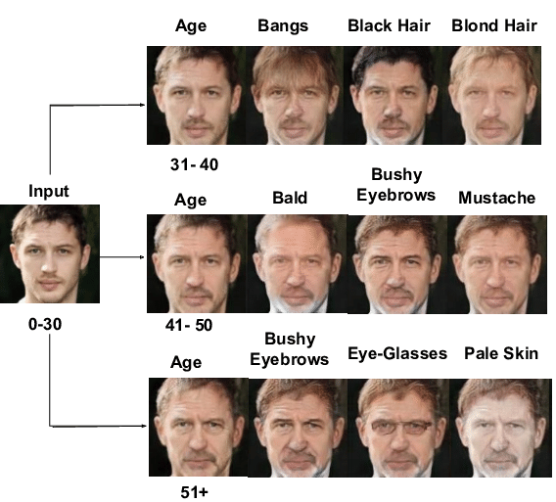
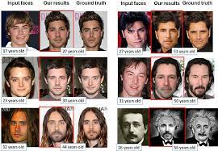
RESULTS
10

Slide 11


